Slide 1
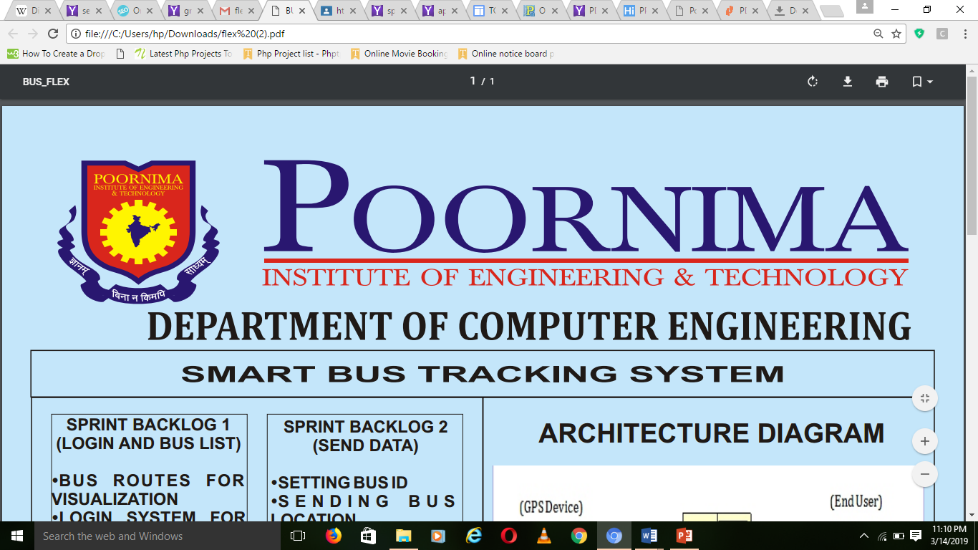
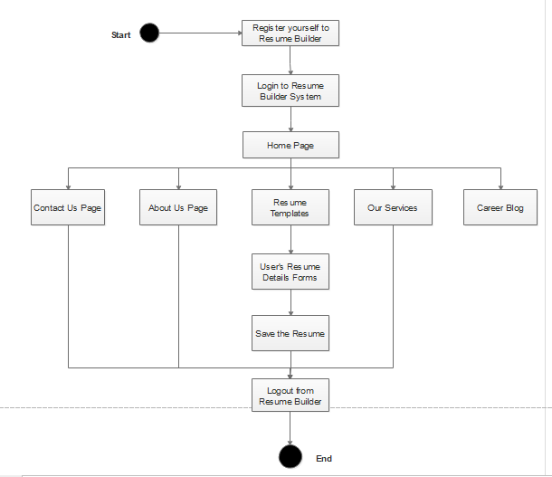
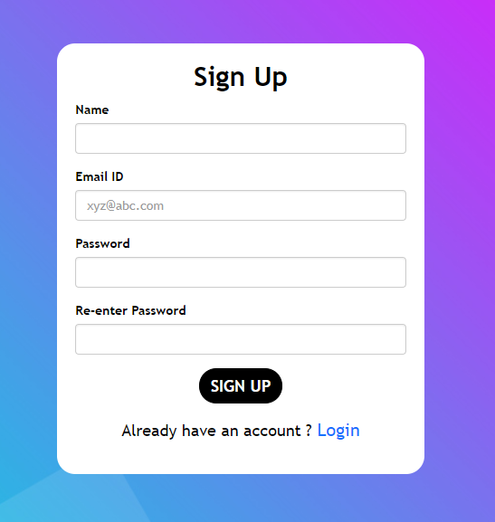
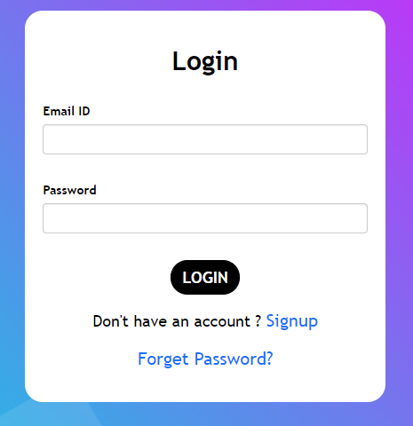
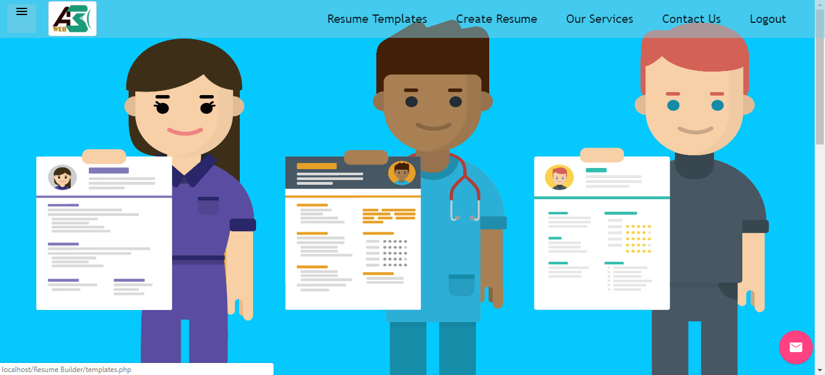
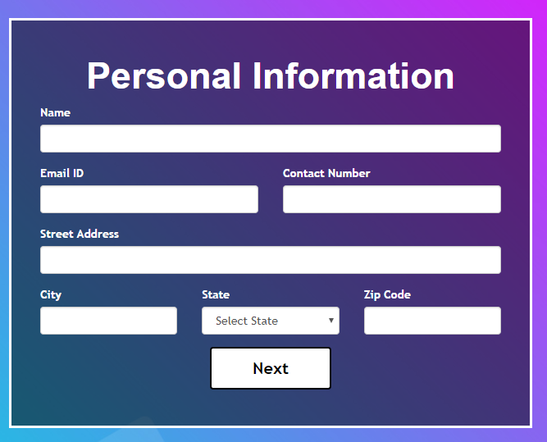
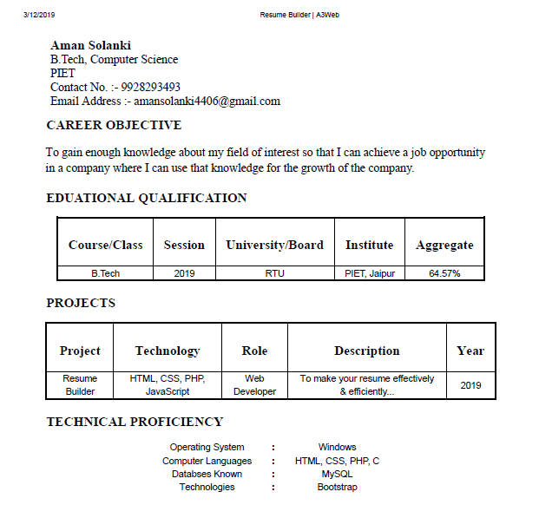
RESUME BUILDER
SPRINT BACKLOG 1
(REGISTER AND LOGIN)
USER CAN SIGNUP
THE USER CAN LOGIN
SPRINT BACKLOG 2
(DATABASE CONNECTIVITY)
FETCH THE DATA FROM DATABASE
ARCHITECTURE DIAGRAM
+
APPLICATION
SPRINT BACKLOG 3
(SESSION HANDLING)
THE SESSION IS
MAINTAINED FOR PROPER
FUNCTIONING.
SPRINT BACKLOG 4
(RESUME CREATION)
THE USERS CAN SEE AND
DOWNLOAD THEIR RESUME
FOR FRESHERS TO START CAREER AND PROFESSION
PROJECT GUIDE :
DR.REKHA JAIN
PROFESSOR
PIET/2018-19
ABHINAV SHARMA(PIET15CE004), ADITYA RANGA(PIET15CE008), AMAN SOLANKI (PIET15CE014)

